Slide 1
2D Viewing Transformation
Sunirmal Khatua
Department of Computer Science & Engineering
University of Calcutta

Slide 2
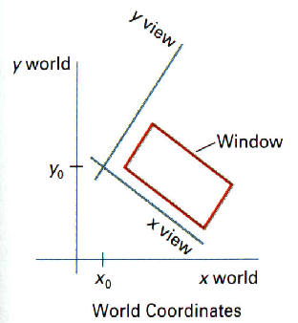
Basic Definitions
World Coordinate Frame.
Viewing Coordinate Frame.
Device Coordinate Frame.
Window.
Viewport.
y device
Viewport
x device

Slide 3
Viewing Transformation Pipeline
World Coordinate
to
Viewing Coordinate
MC
Construct World Coordinate Scene
WC
VC
Viewing Coordinate
To
Normalized VC
Normalized VC
To
Device Coordinate
DC
NVC

Slide 4
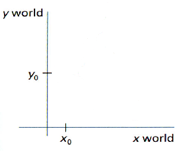
WC-VC Transformation
Translate to World Coordinate Origin.
Rotate to align with World Coordinate.
M_{WC,VC} = R(ɵ). T(-x₀,-y₀)
y view
x view

Slide 5
Window to Viewport Transformation
yw_{max}
yv_{max}
(xw,yw)
(xv,yv)
yw_{min}
yv_{min}
xw_{min}
xw_{max}
xv_{min}
xv_{max}
M_{window,viewport} = T(xv_{min},yv_{min}) . S(s_{x}, s_{y}) . T(-xw_{min},-yw_{min})
xv_{max} – xv_{min}
s_{x} =
xw_{max} – xw_{min}
yv_{max} – yv_{min}
s_{y} =
yw_{max} – yw_{min}

